Slide 1
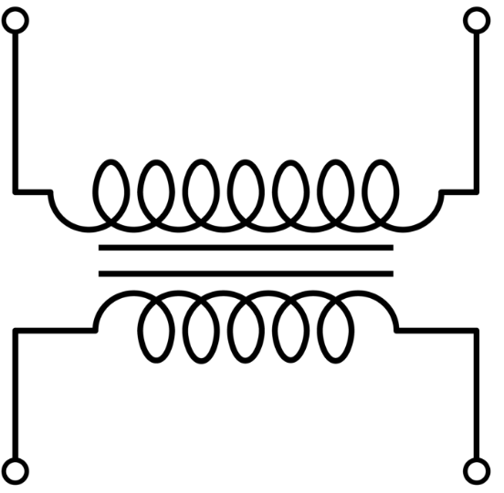
ANSWER SHEET
HVAC Schematic Symbols
Transformer
Contact – normally open
Contact – normally closed
Pressure Switch – normally open
Temperature Switch – normally closed
Thermal Overload – normally closed

Slide 2
ANSWER SHEET
Split-System Air Conditioner
Basic troubleshooting
Name three (3) things that can cause high head pressure.
Dirty Condenser coil Bad Condenser fan
Overcharged Air in the system
Name three (3) things that can cause low suction pressure.
Dirty Evaporator coil Bad evaporator fan
Loss of charge Blocked or closed metering device
Dirty air filter
What may indicate that a TXV is stuck closed?
High superheat Low section pressure
Compressor hot to the touch
What may indicate that a TXV is stuck open?
Little to no Superheat Refrigerant flood back
Compressor cold or frozen
How can you check to see if a fan relay, or contactor, is bad?
Ohm out the coil
Check the continuity of the dry contacts while energized/de-energized
What may cause high amp draw on a blower, or condenser motor?
Low voltage Bad capacitor
Worn bearings
List some possibilities that keep a compressor from operating when you have a proven call for cooling?
Bad contactor Off on thermal overload
Off on pressure control safety
What resistance would you expect to see across a set of closed contacts?
None, or zero ohms
What voltage would you expect to see between common and terminal “G” with the equipment energized, and the fan in the “on” position?
24 volts

