Slide 1
Energy and Carbon Reduction Plan
May 21, 2014

Slide 2
Initial Site Evaluation
Initial site energy benchmark was performed in 2006 using the US Department of Energy’s benchmarking software . Our Campus buildings initial scores for the four Plazas were: 23, 15, 01, and 01.

Slide 3
First steps
Based on the low energy scores, the buildings underwent a more thorough evaluation to determine which areas needed to be addressed.
The initial energy study showed very high annual electrical usage (15,899,568 kWh/year) and water consumption (11,276,589 gallons/year).
The campus mechanical infrastructure was found to be mostly working as designed, but the systems had been installed prior to the Energy Policy Act of 1992 and were not designed to be energy efficient.

Slide 4
Program Creation
About the same time, in early 2007, Munich RE announced its plan to move towards Carbon Neutrality by 2012. The Munich Re Energy Reduction Plan was created over a 12-month period starting in 2007 and based on metrics and guidelines established in:
the US Energy Policy Act of 2005
the LEED for Existing Buildings: Operations and Maintenance Rating System (version for USGBC member ballot in October 2007)
the 2006 International Energy Conservation Code
the ASHRAE Standard 90.1-2004 (The plan was revised where possible to ASHRAE Standard 90.2-2007.)

Slide 5
The Research Phase
In the research phase of the Plan, the Corporate Facilities team:
Identified projects through peers, vendor inquiries, classes and product expositions.
Compiled more detailed "building-energy" models using ten years of utility bills to create average usage and baselines for systems.
Used initial in-house calculations and models for budgeting consideration and used professionally engineered models to validate projects and savings.

Slide 6
PHASE ONE of the Program Improvements
In 2007, Munich Re introduced the first phase of its Energy use and Carbon Reduction Plan. Campus mechanical systems were upgraded to improve environmental and economic performance. This phase of the Plan included:
the installation of ABB VFD’s throughout the campus (1,011598 kWh/year)
Installation of Watt Stopper occupancy controls at Workstations (132,740 kWh/year)
the installation of the Automated Logic WebCTRL system. Building Automation System (3,500,000 kWh/year)
the replacement of the two P2 150-ton chillers (93,400 kWh/year)
Lighting upgrades replacing T8 light fixtures with T5 (1,800,000 kWh/year)
The installation of a centrally automated IP based lighting controls system (1,300,000 kWh/year)
By the end of 2012 the campus annual energy usage fell to 8,053,768 kWh (a reduction of almost 50% from 2007).

Slide 7
Other CO2 Savings
RECYCLING: In addition to the improved energy efficiency, the campus increased its recycling of plastic, paper, cardboard, commingles, carpet, organic waste, construction waste, and hazardous wastes. Campus recycling has improved from less than 30% to over 70%.
WATER EFFICIENCY: The campus also improved irrigation controls and upgraded to waterless urinals, 1.28 g.p.f. toilets, touch-less faucets, and improved cooling tower chemical controls. These improvements reduced water usage by 31% (to 7,854,030 gallons per year)
.

Slide 8
Performance Measures
The combined effect of these improvements was a dramatic decrease in the campus Carbon Footprint. Munich Re had requested each entity reduce its Carbon Footprint by 12% by 2012. Because of the attractive ROI of many of the efficiency projects, Munich Re Princeton was able to reduce its foot print by 65% off its 2007 number (55% below the 2009 baseline year established).

Slide 9
Awards and recognition
The campus improvements and sustainability program were recognized by numerous national and international industry organizations.
On September 25, 2012, the 4 buildings on the Princeton campus earned the BOMA 360 Performance Building designation (presented by Building Owners & Managers Association International. Designation is awarded to properties managed to the BOMA’s highest standards of excellence). Only 10 buildings in the state of New Jersey have earned this designation.
Also in 2012, the company successfully completed the BOMA 7 – Point Challenge (an encompassing energy reduction program challenging members of Building Owners & Managers Association International to decrease energy consumption by a minimum of 30 percent across company portfolios by 2012). Munich Re received special recognition for the greatest reduction on a percentage basis in the program.

Slide 10
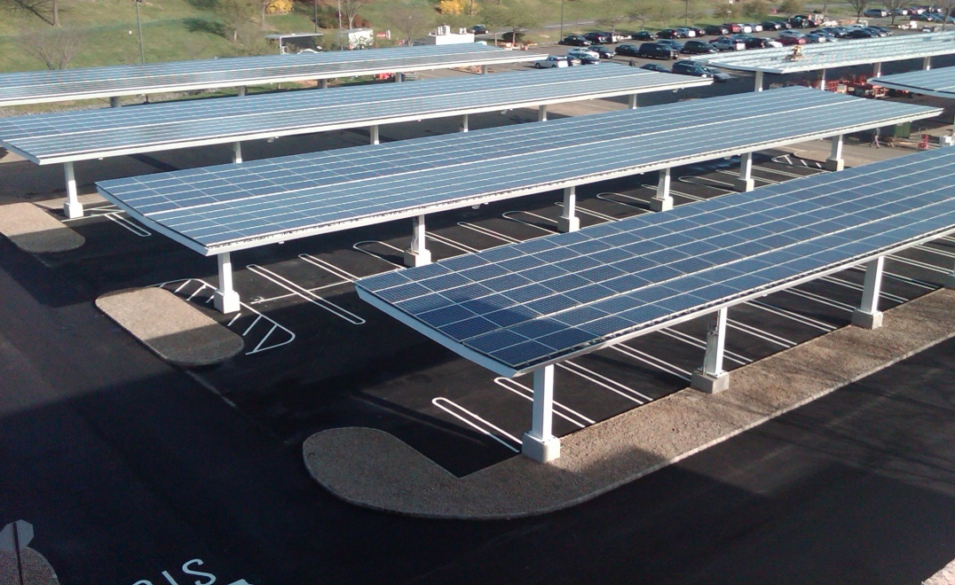
PHASE TWO of the Program Improvements
In August 2012, Munich Re completed the second phase of its Energy and Carbon Reduction Plan. The company completed construction on a 2.47 mW solar canopy system over the Plazas I and II parking lots, supplying the campus with:
Approximately 3,122,077 kWh of zero carbon energy annually.
Over 100,000 cubic feet of storm water recharge chambers installed below the parking lots to reduce the storm water runoff on campus.
A significantly reduced Heat Island effect in the large parking lots on campus.

Slide 11
Site Re-evaluation
The buildings initial benchmarks using the EPA Portfolio Manager had scores of: 23 (Plaza I), 15 (Plaza II), 01 (Plaza III), and 01 (Plaza IV).
In 2013, the buildings were re-evaluated. Scores improved dramatically to: 75 (Plaza I), 92 (Plaza II), 60 (Plaza III), and 46 (Plaza IV).
In addition, Plaza’s III and IV are undergoing further improvements to ensure the company achieves a campus wide “Energy Star” certification.

Slide 12
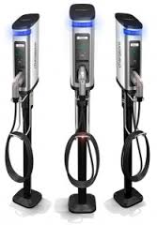
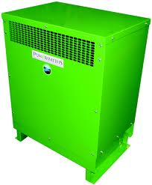
The Next Steps…
Munich Re is currently:
Replacing 57 inefficient transformers on site (est. energy savings: 402,153 kWh/year).
Replacing Plaza 1 Cooling plant (est. energy savings: 200,000 kWh/year).
Preparing to install upgraded Bicycle Racks and electric car charging stations on campus to promote zero emission commuting.
Adding Natural gas pre-heating to the campus to decrease the use of Indirect energy in favor of the more efficient direct energy heating source. (est. energy savings to be provided as part of engineering of project).

Slide 13
The Next Steps…
In addition, the company has started working towards submitting for campus wide LEED certification.
LEED, or Leadership in Energy & Environmental Design, is a certification program created by the US Green Building Council that provides third-party verification of sustainability and efficiency programs in buildings.
Plaza 2 is currently in final LEED review with the expectation of receiving Silver certification in 2014.
Plaza 3 is on target for a 2Q submission with the expectation of LEED Gold certification.
The entire campus is expected to qualify for at least LEED Silver certification by 2015.

Slide 14
2015 Targets (Energy Costs)
The Munich Re Energy and Carbon Reduction Plan has used the savings created by its initial phases to help fund the continuation and improvement of the Plan. Savings created by initial projects and phases currently in planning are on target to reduce annual energy costs by $1,300,000.

Slide 15
2015 Targets (Energy Use and Energy Star Ratings)
The upcoming MRAm Energy and Carbon Reduction Plan projects are expected to continue the energy use reduction and energy ratings improvement on campus through 2015 .

